Slide 1

AI/ML
Patrick Christmas
Daniel Santillan

Slide 2

OUTLINE
What is AI/ML?
Dataset training with k-nearest-neighbor
Hyperparameter tuning
Confusion matrices

Slide 3
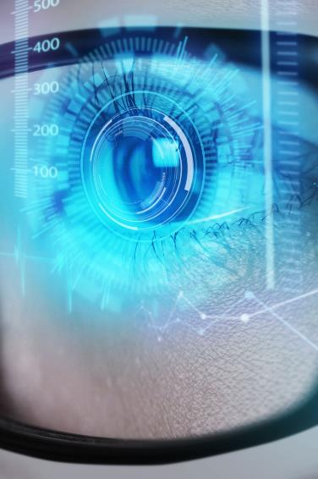
What is AI/ML?
Artificial intelligence (AI)
Computer system development allowing it to mimic human intelligence
comprehension, problem solving, decision making, autonomy, etc.
MACHINE LEARNING
Process by which a computer learns through patterns in datasets
“learning by experience”
DEEP LEARNING
Subset of machine learning – using “neural networks to learn complex patterns
Requires larger datasets and computational resources

Slide 4
K-nearest-neighbor
Supervised learning
Machine learning with labeled data – the data includes the “correct” answers
AI develops an algorithm through supervised learning before working with unlabeled data
What is k-nearest neighbor?
Identify the k (some number) closest data points to an unlabeled data point and assigning it to a category
Think of it as if you are sorting fruits by color/shape

Slide 5
Hyperparameter tuning
Process of selecting optimal values for machine learning hyperparameters
Hyperparameters – setting used by machine learning model before training and helps define the learning process
Various methods
Brute Force
Random Search
Bayesian Optimization

Slide 6
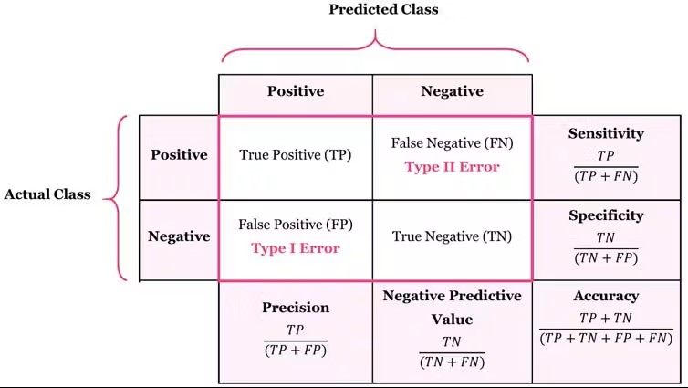
Accuracy/confusion matrices
Calculates accuracy of machine learning
Results starting from 0.7 demonstrate a good model
Accuracy = (TP + TN)/(TP + TN + FP + FN)

Slide 7

Concept application google colab

Slide 8

Thank you
Enjoy the rest of HackBI IX!

